Slide 1


Applying NLP & ML for CSS Case studies in public health
Social Media on Obesity, Mental Health, Loneliness
Yelena Mejova
ISI Foundation, Italy
SocialComQuant Summer School, July 28, 2022, Koç University, Istanbul, Turkiye

Slide 2
How does one create a complete study?

Slide 3
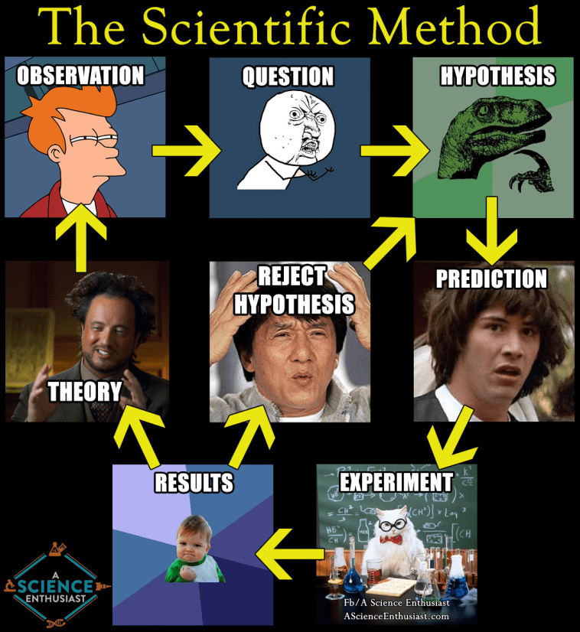

Slide 4




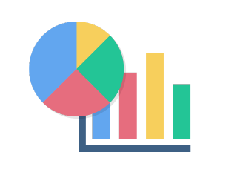




Hypothesis formation
+ previous literature
Extract signals
Collect data
keyword refinement
information retrieval
Refine data
relevance classification
bot/anomaly detection
activity
statistics
behavior
classification/
characterization
social
classification/
characterization
Perform analysis
characterization
comparison
hypothesis testing
Relate to external data
surveys
census
events
geolocation
…
Draw conclusions
+ previous literature

Slide 5
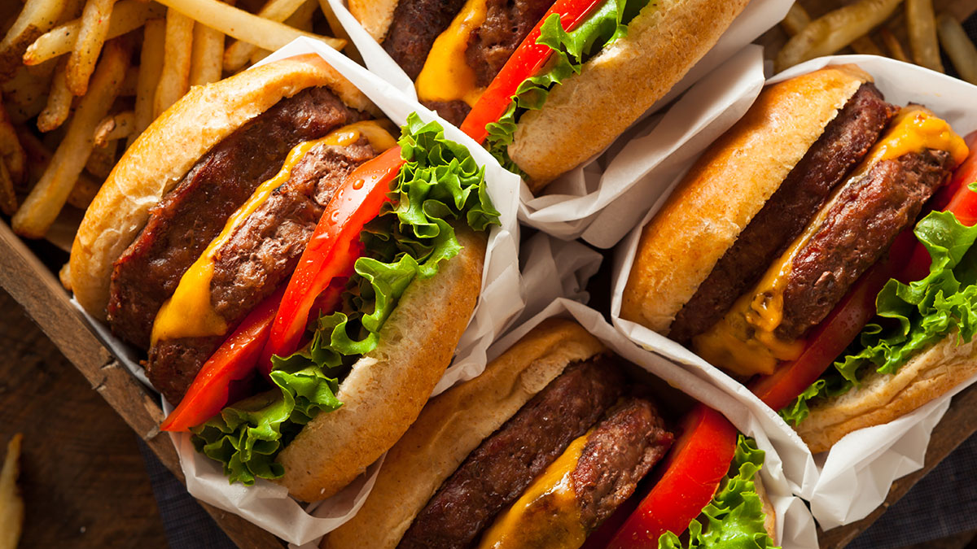
tracking ”lifestyle” diseases

Slide 6

Case study: obesity
“lifestyle diseases”
Behaviors: smoking, unhealthy diet, and physical inactivity
Chronic diseases: heart disease, stroke, diabetes (II), obesity, metabolic syndrome, chronic obstructive pulmonary disease, and some types of cancer
Environmental considerations
Food deserts
Socio-economic inequality
Social media
Captures behaviors, beliefs, intentions, trust, etc.
https://www.un.org/en/chronicle/article/lifestyle-diseases-economic-burden-health-services

Slide 7
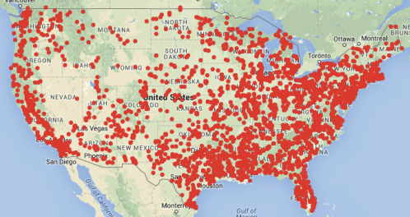
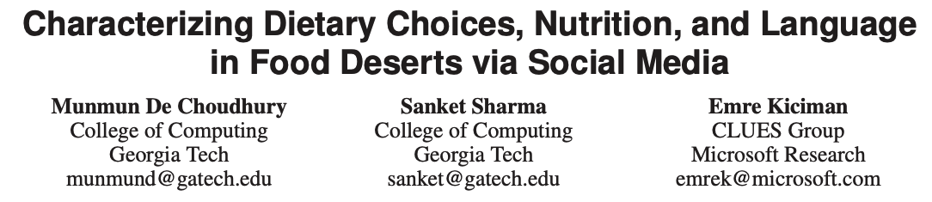
Example: food deserts
Use Instagram posts to track nutritional value of posts in food deserts
Find content from food deserts is higher in fat, cholesterol, and sugar

Slide 8
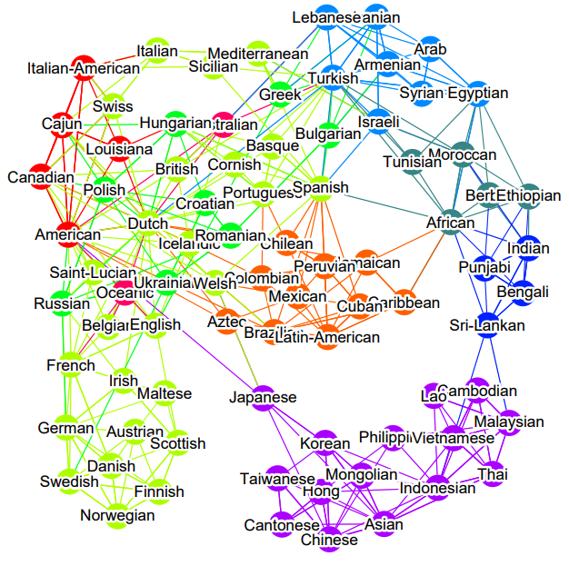
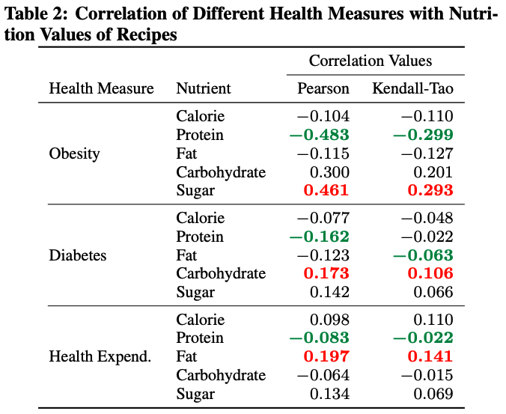
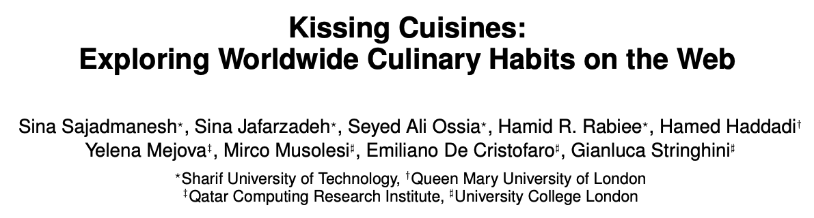
Example: recipe networks
Use recipes around the world to understand connections between cuisines
Correlate nutrition value to country health statistics

Slide 9
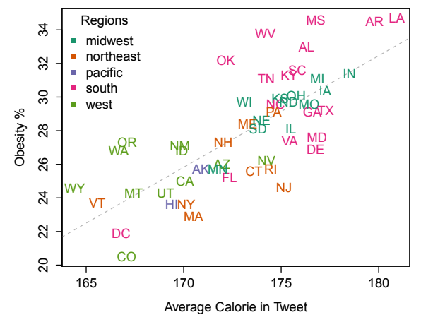
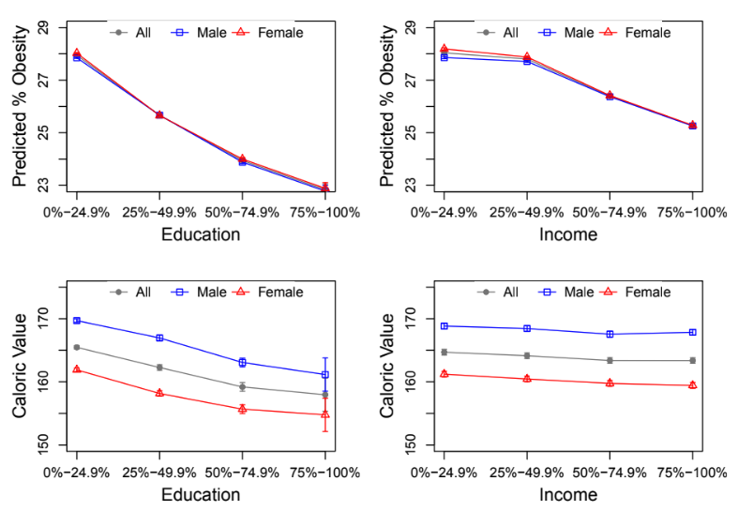
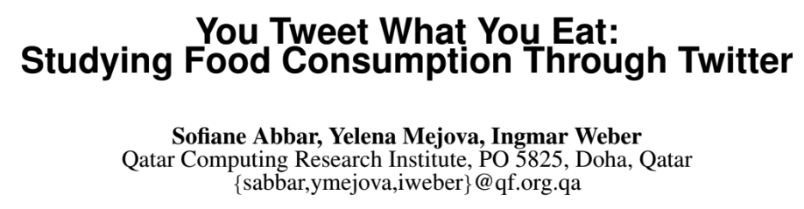
Example: obesity & diabetes
Use Twitter posts to calculate caloric value of mentioned foods
Relate caloric values to health statistics in states within USA

Slide 10
Methodology
Data collection
Keywords, iterative
Geo-location
Relating text, post or users to a location
Enriching text with health-related information
Mapping to foods, nutritional information
Comparing to known health statistics
Correlation, regression

Slide 11
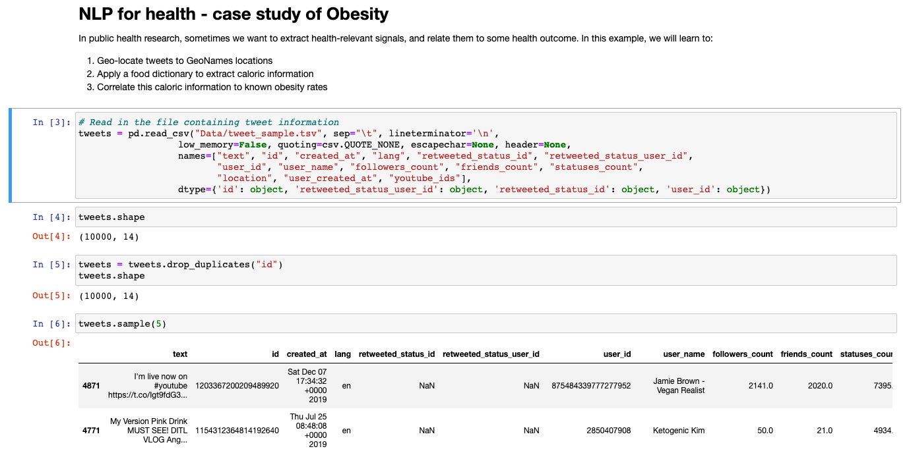
Obesity.ipynb

Slide 12
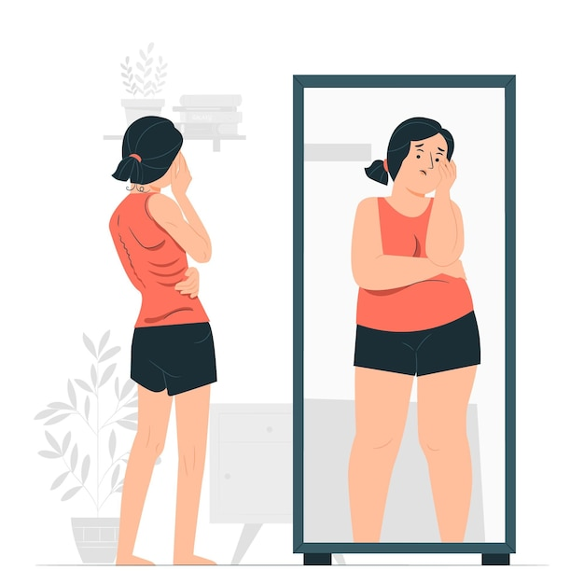
understanding mental health: anorexia warning: potentially disturbing topic

Slide 13
Case study: eating disorders
Eating disorders
Anorexia nervosa
Bulimia nervosa
Binge eating disorder
Avoidant restrictive food intake
Orthorexia
Compulsive exercise
Often have “support groups” on social media (also for recovery)
Body culture, fitness/wellness industry
https://www.nationaleatingdisorders.org/warning-signs-and-symptoms

Slide 14
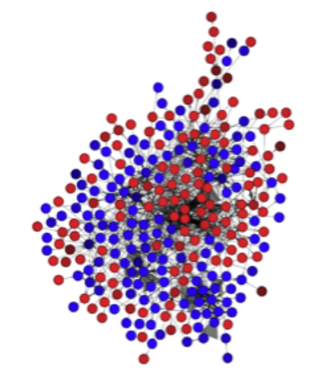
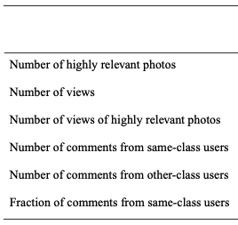
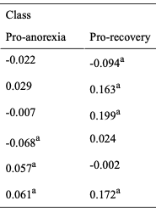
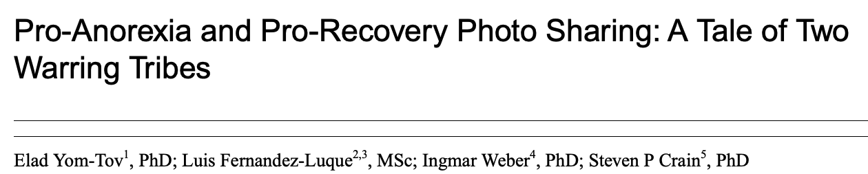
Example: pro- and anti-anorexia
Use Flickr image sharing to find pro-anorexia and pro-recovery communities
Find that comments by pro-recovery users on pro-anorexia content is associated with these users staying in the community longer

Slide 15
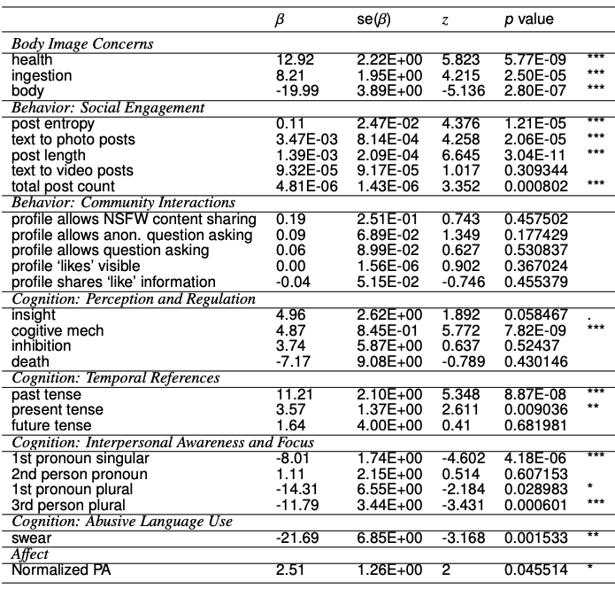

Example: examinine anorexia recovery
Use posts on Tumblr to find users who show signs of recovery from anorexia
Find cognitive markers of recovery, including self-reflection, positive affect, focus on food and nourishment

Slide 16
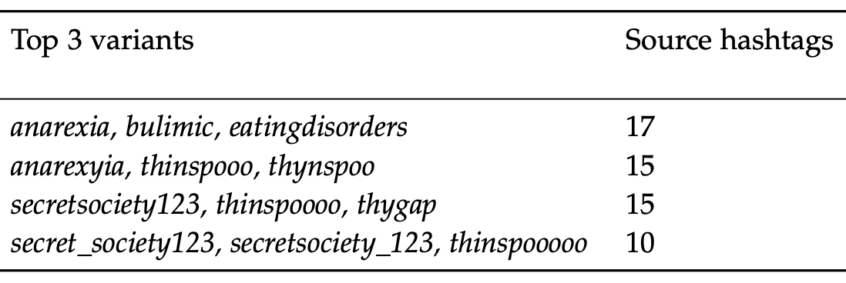
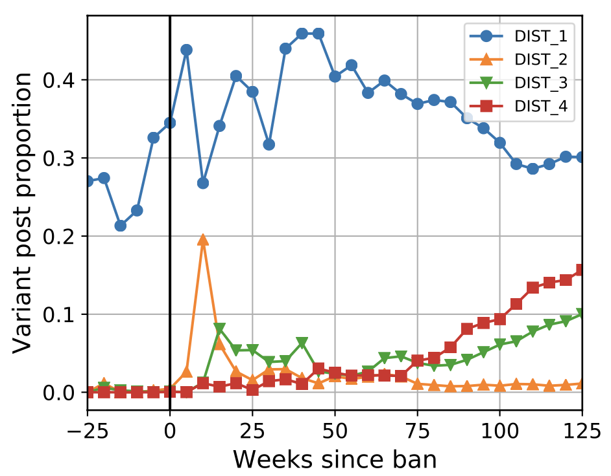
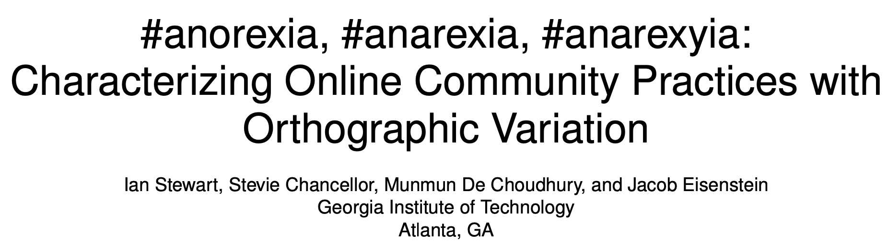
Example: avoiding detection
Examine Instagram posts having pro-anorexia tags which are at some point banned by the platform
Find that community adopts tags with orthographic variation to avoid detection, mostly driven by new community members

Slide 17
Methodology
Data collection
user-focused vs keyword-focused
Comparing communities
network interactions, posting behaviors, word/topic use
Understanding topical focus
with focus on particular issues
Linguistic analysis
use of words in cognitive, affective, etc. categories

Slide 18
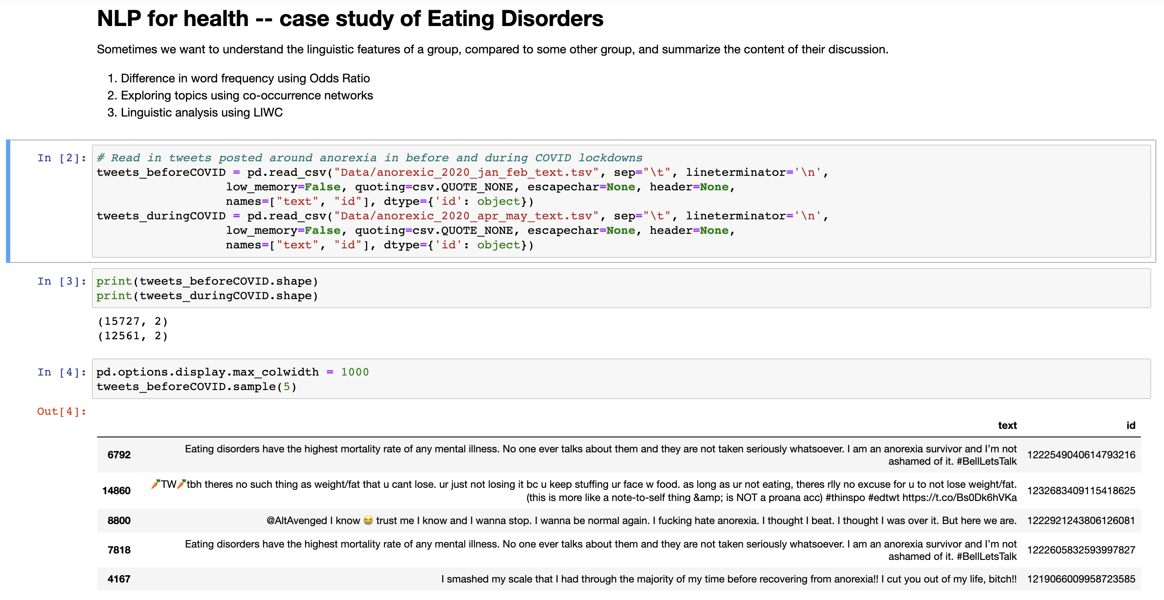
MentalHealth.ipynb

Slide 19

tracking loneliness

Slide 20

Case study: loneliness
Loneliness is considered at epidemic levels in the US and is a concern in other countries
Associated with poor mental health and physical health outcomes
Social media is increasingly socially acceptable outlet for expressing emotions and building social ties

Slide 21
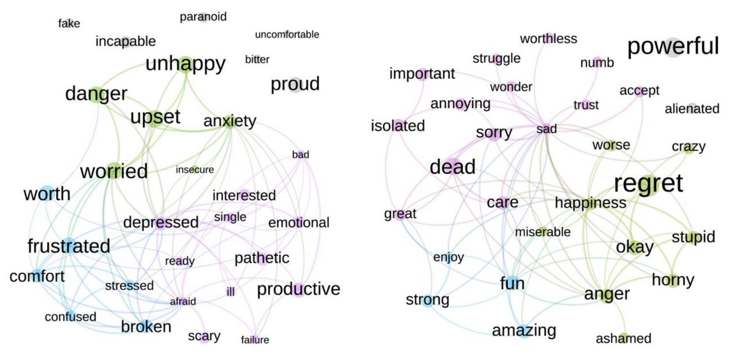
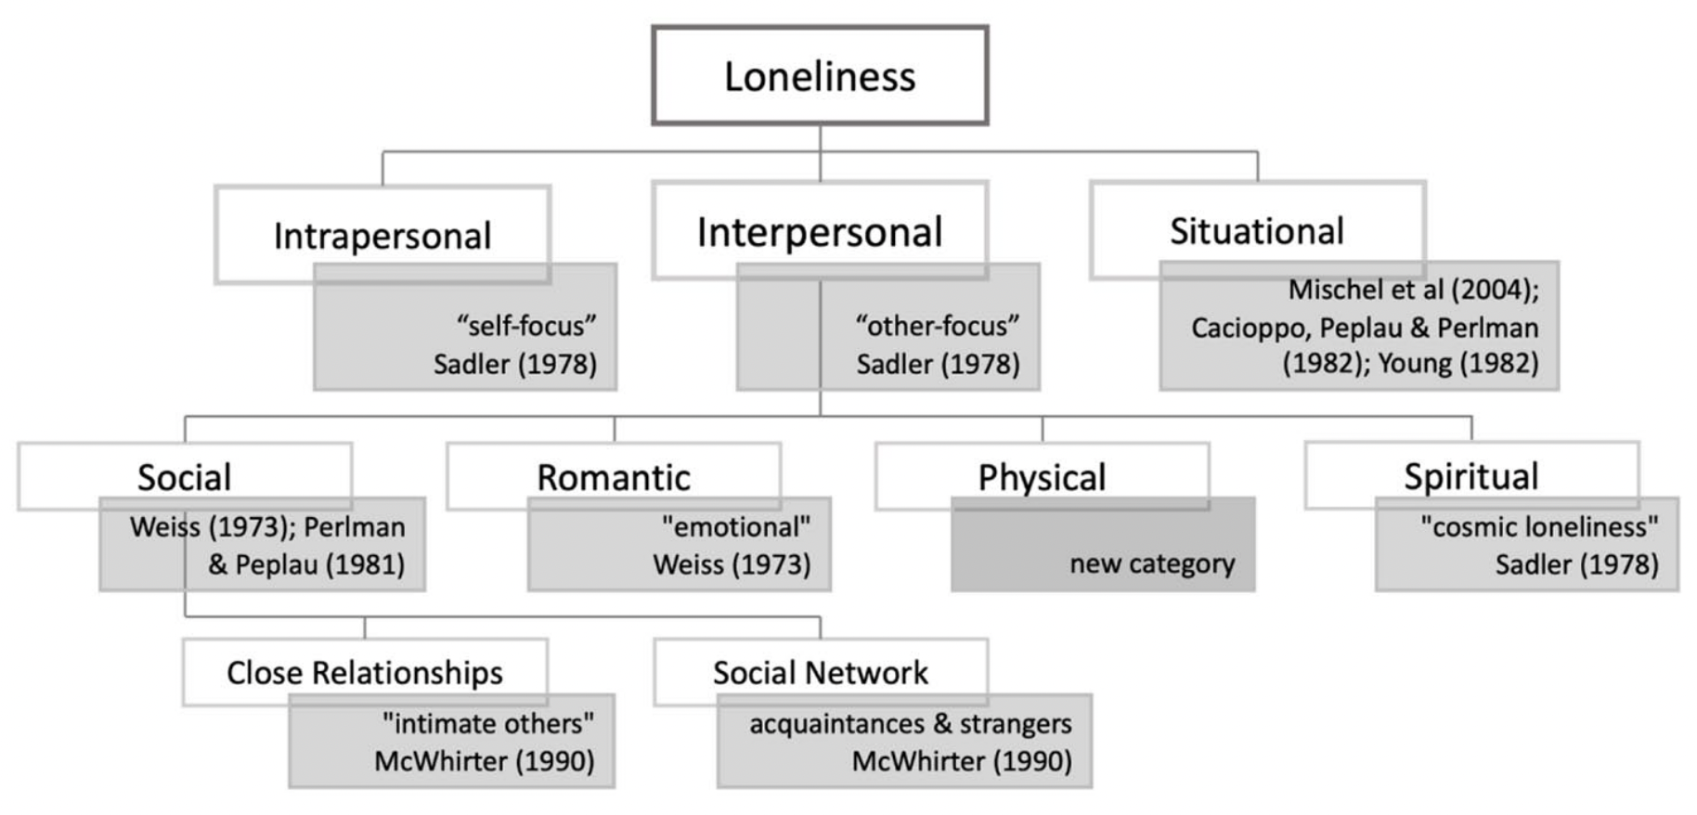
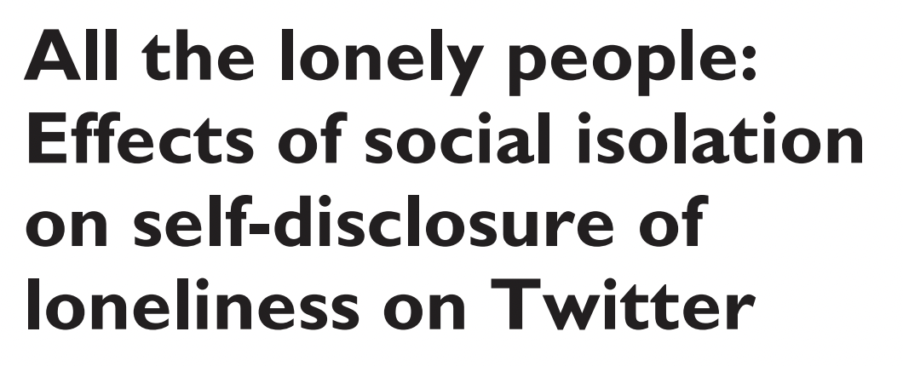
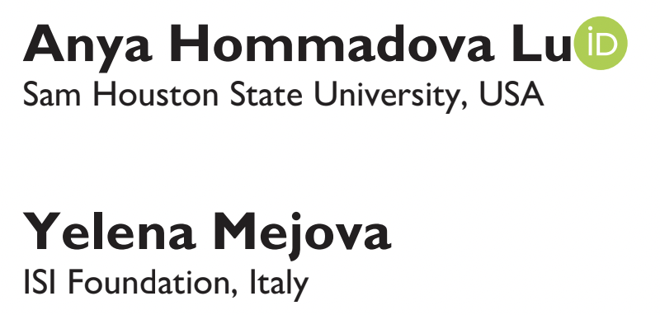
Example: loneliness during COVID-19
Examine Twitter posts before and during COVID-19 to measure rates of loneliness self-disclosure
Track the change in emotional expression and extend typology of loneliness from previous literature

Slide 22
Methodology
Data collection
keyword-focused
Data refinement
using supervised machine learning classifier
Understanding emotional focus
sentiment analysis
Detecting change over time
did behavior change after an event?

Slide 23
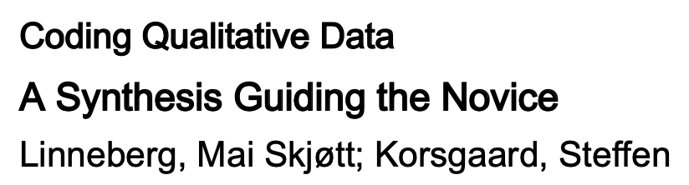
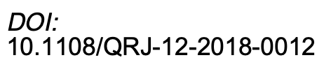
Bonus: data annotation
where does “training data” come from?
Deductive coding
Pre-defined codes/classes
Good for training ML classifiers and comparing across papers
Doesn’t always fit the data
Inductive coding
Developing codes directly from data
“Grounded theory”
Good for understanding data and developing research questions
Inter-annotator agreement
How difficult is the task?
Crowdsourcing
Only for easiest smallest tasks

Slide 24
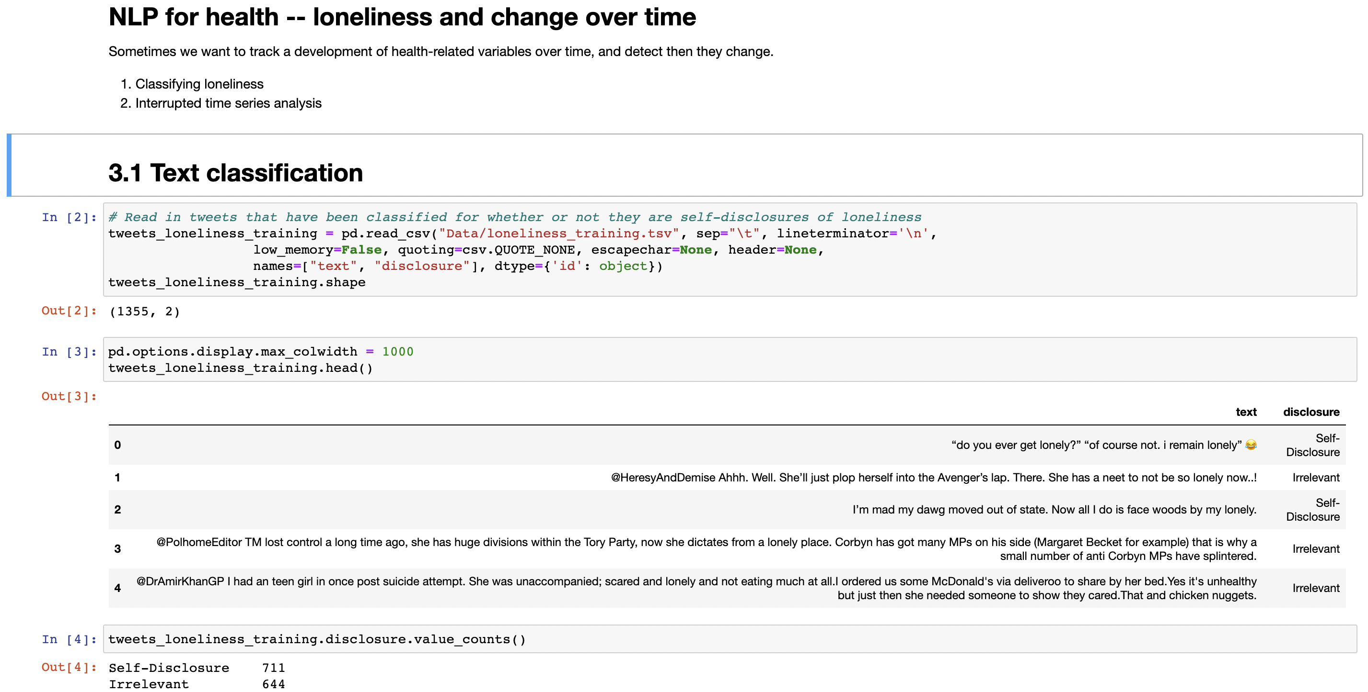
Loneliness.ipynb

Slide 25
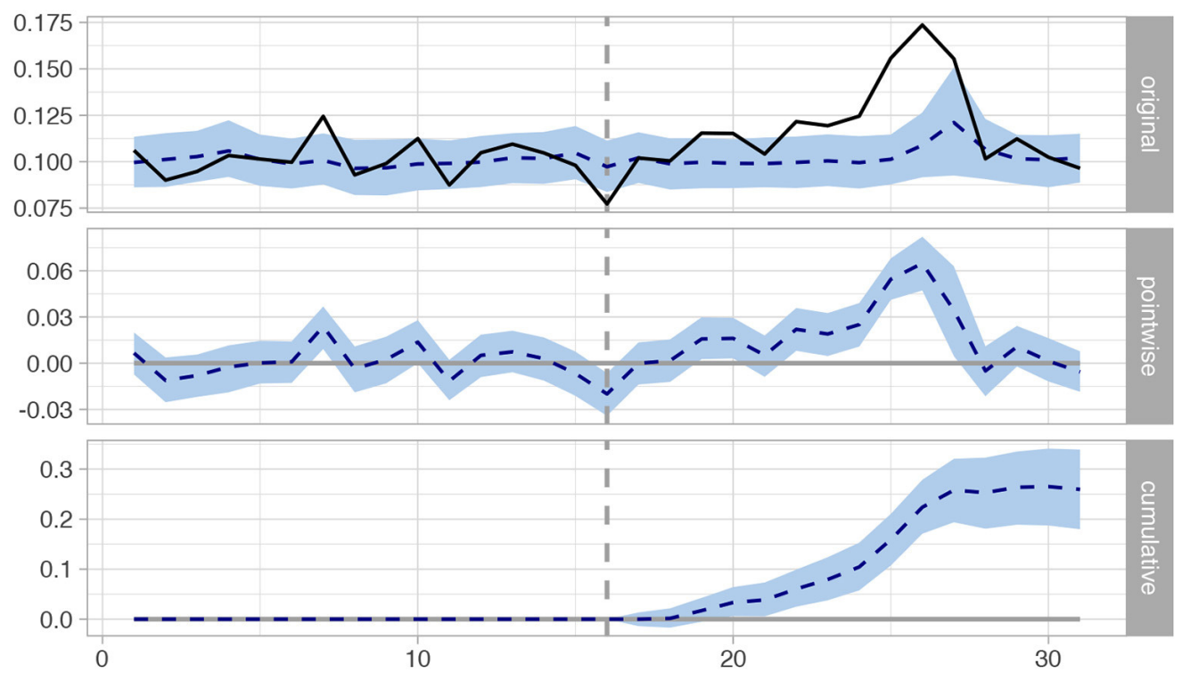
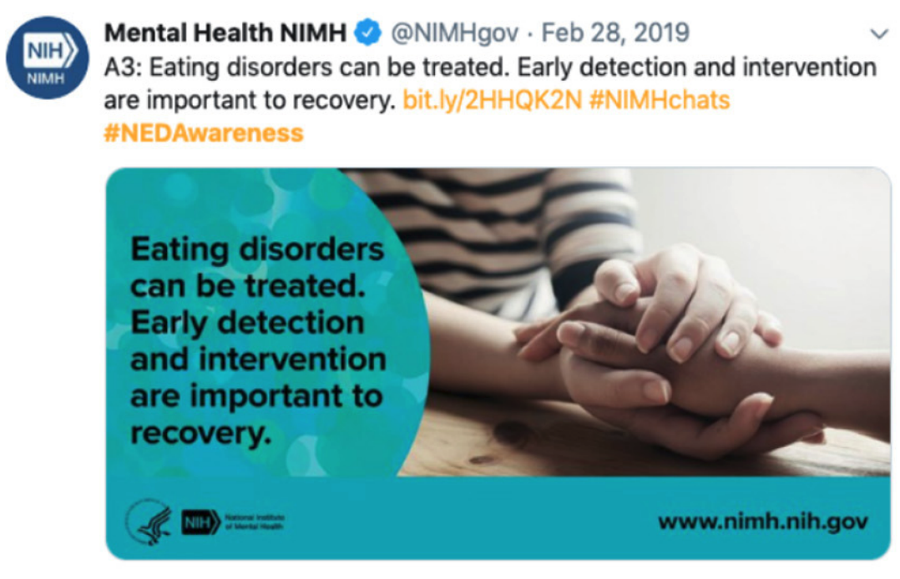
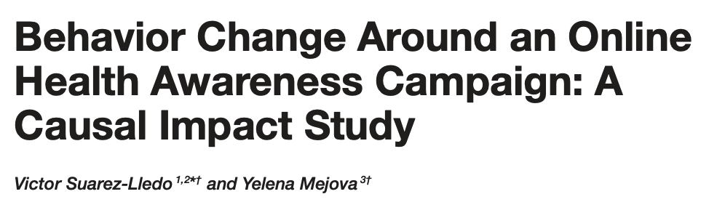
Also: change in behavior vs. baseline
How does the use of LIWC categories change for a target set of users, compared to a baseline set, after an intervention?
Use Causal Impact package (R)
https://google.github.io/CausalImpact/CausalImpact.html

Slide 26
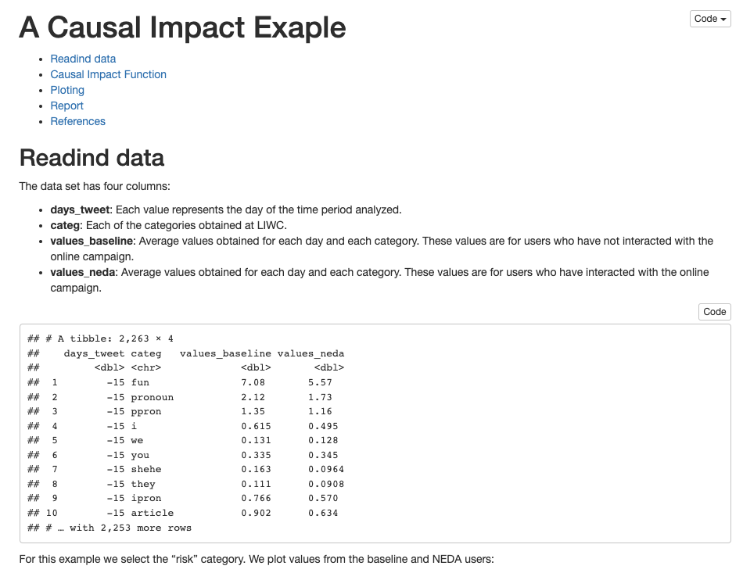
R
by Victor Suarez-Lledo
example_causal_impact.html
example_causal_impact.Rmd

Slide 27
Questions?
yelena.mejova@isi.it
@yelenamejova

